Slide 1
PROJECT REVIEW
A File Versioning and
Recovery System
Track. Compare. Recover.
A system to store, track, compare and recover every version of a file
P. Neeharika
S. Chakrika
G. Shivani
2520090233
2520090044
2520090046

Slide 2
01 · CONTEXT
Problem Statement
Files are frequently modified and updated, and every overwrite risks losing the work that came before it. Without a structured way to track changes, recovering an earlier version is left entirely to chance.
The Risk Today
One overwrite
!
Version loss
is enough to permanently erase earlier work with no undo path
When a file is overwritten, the previous version may be lost permanently.
Manual copies
!
Manual chaos
are the only workaround most users rely on today
Managing multiple manually-named copies of the same file is confusing and error-prone.
Zero
!
No recovery path
structured way to compare or recover an older version
It is difficult to track down and restore an older version once changes are made.
File Versioning & Recovery System
2

Slide 3
02 · GOALS
Objectives
What this project sets out to achieve, mapped to the problems identified above.
01
02
Maintain version history
Prevent data loss
Keep every past version of a file rather than overwriting it.
Ensure previous file versions are never lost when a file changes.
03
04
Organized history
View version details
Present the full history of edits in a clear, structured way.
Let users inspect version number, date and modification info.
05
06
Compare versions
Controlled recovery
Show the differences between two chosen versions of a file.
Restore an earlier version, and cap storage with a version limit.
File Versioning & Recovery System
3

Slide 4
03 · APPROACH
Proposed System
The system stores a new version whenever a file is modified, instead of directly replacing the previous version.
Version Lifecycle
Storage & Organization
Create a new version whenever a file is modified
View the complete version history of a file
View detailed information about a specific version
Compare two different versions of a file
Restore an earlier version when required
Organized, structured file storage
Set a maximum number of versions per file
Automatically remove the oldest version once the limit is reached
Keep storage usage predictable over time
How it works
File modified → new version created → previous version kept in history → limit check → oldest version auto-removed if over the cap
File Versioning & Recovery System
4

Slide 5
04 · DESIGN
System Architecture
User
Design Notes
Uploads, modifies, views, compares and restores files.
Java backend owns all version creation, comparison and recovery logic.
MySQL stores file & version metadata separately from the physical file content.
Local file storage keeps a physical copy of every retained version.
The version-limit rule automatically removes the oldest version once the cap is reached.
↓
Frontend — HTML, CSS, JavaScript
The interface for browsing files, folders, versions and settings.
↓
Backend — Java
Core application logic: version creation, comparison and recovery.
↓
MySQL Database + Local File Storage
Stores file & version metadata, and the physical version files.
File Versioning & Recovery System
5

Slide 6
05 · CAPABILITIES
Modules / Functionalities
01
02
03
File Management
Version History
Version Comparison
Upload files, create new versions, and manage every stored file.
Display all available versions with number, date and time.
Select two versions and identify the changes between them.
04
05
Recovery
Version Limit
Select an older version and restore it as the current one.
Cap the maximum number of versions and auto-remove the oldest.
File Versioning & Recovery System
6

Slide 7
06 · FRONTEND
Frontend Design
Key sections of the FileGuard candidate-facing application.
Home
My Files
Recent Activity
Open File, Create File, Recent Files, Managed Folders, Recent Activity.
Displays every tracked file, its path and current version.
Shows file modifications, new versions, date and time.
Managed Folders
Settings
Monitored folders, folder path, file counts, add / remove.
Monitoring toggle, max versions, auto-removal, storage usage.
File Versioning & Recovery System
7

Slide 8
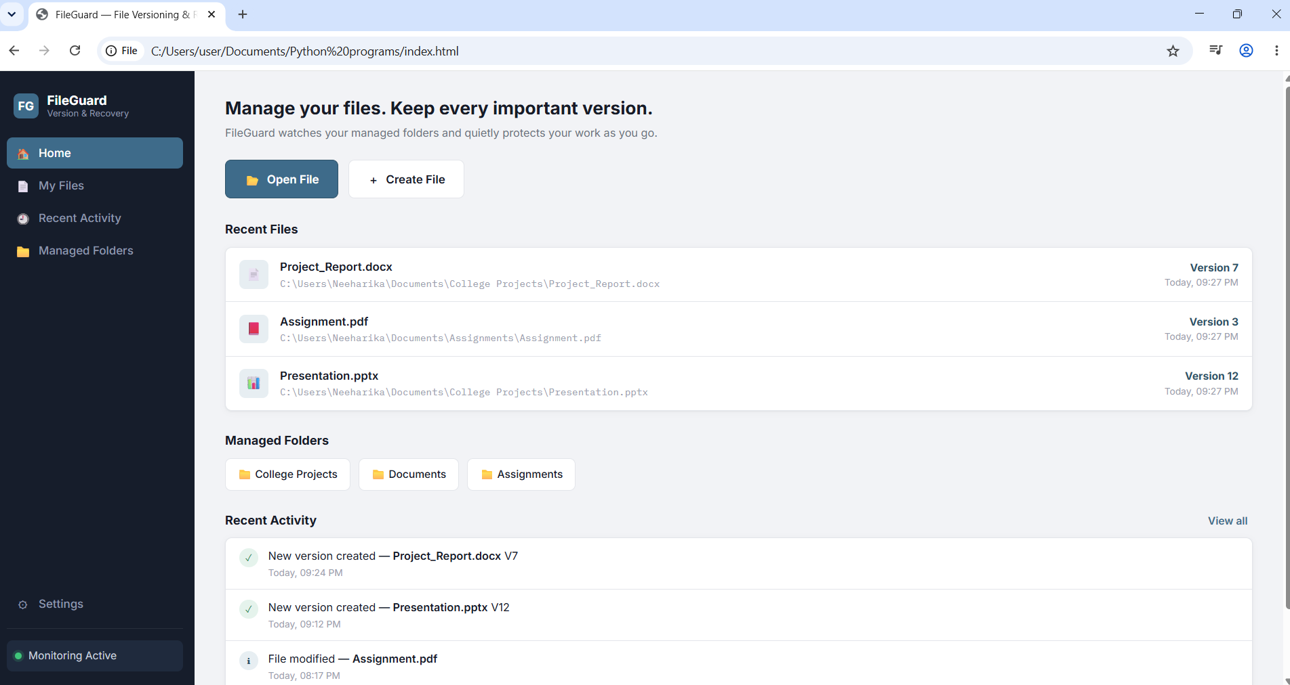
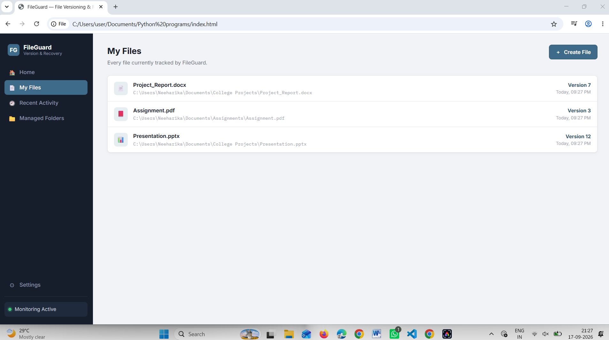
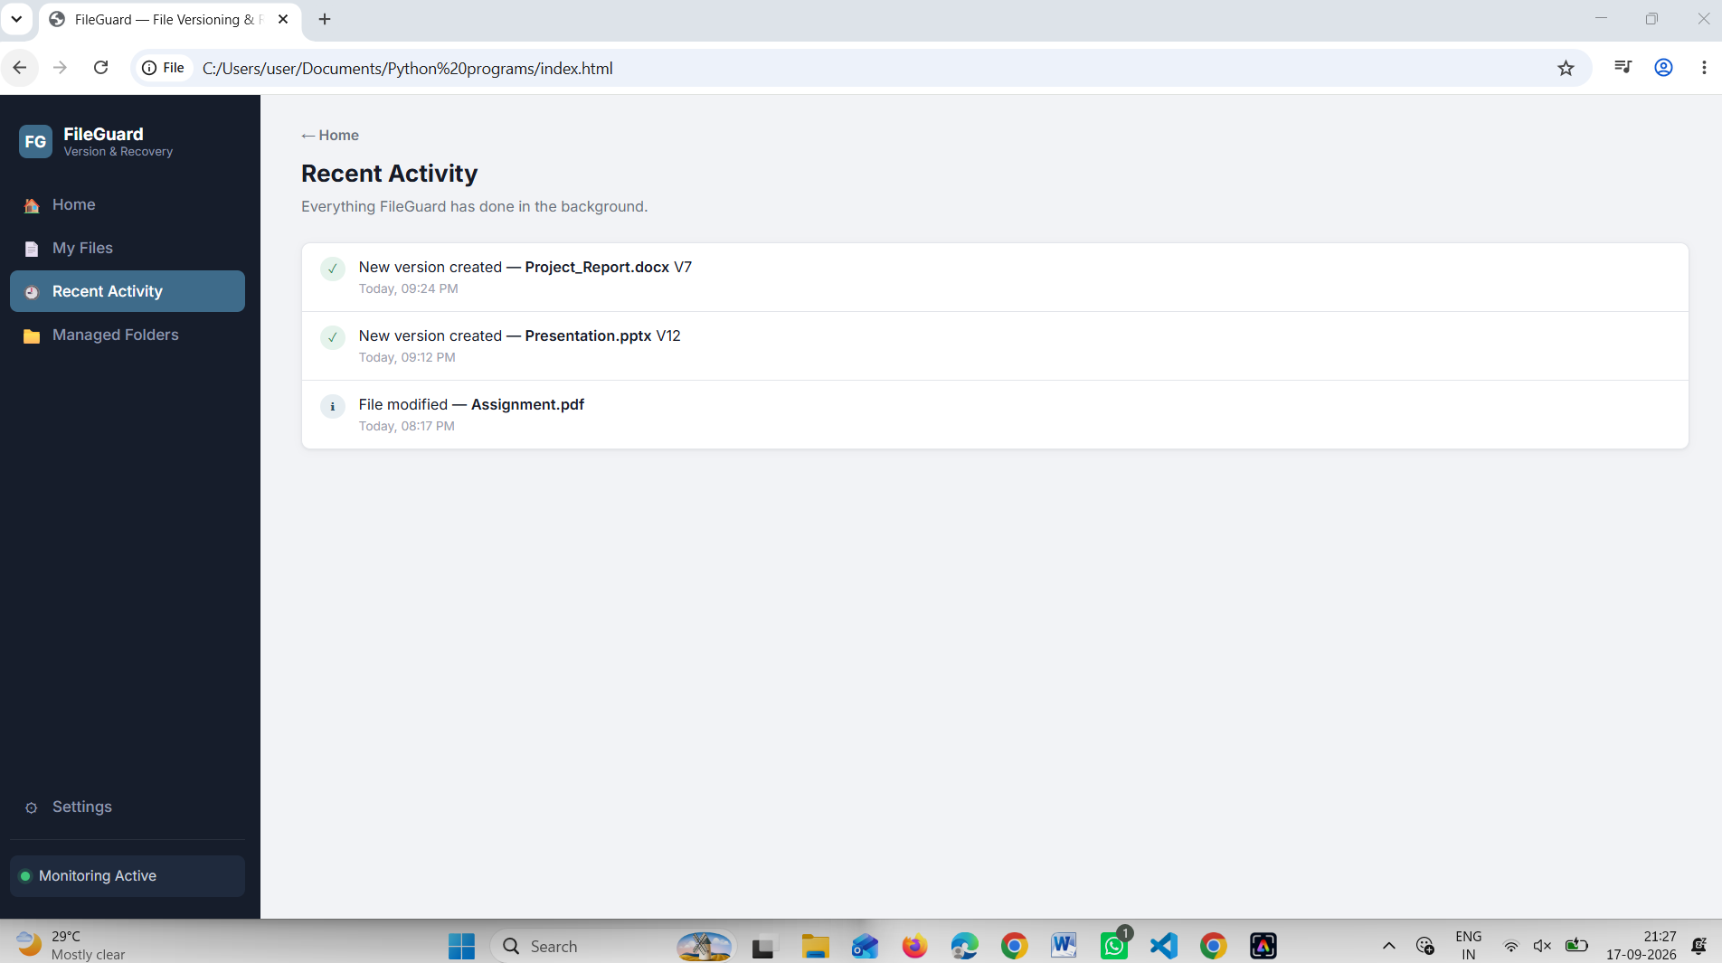
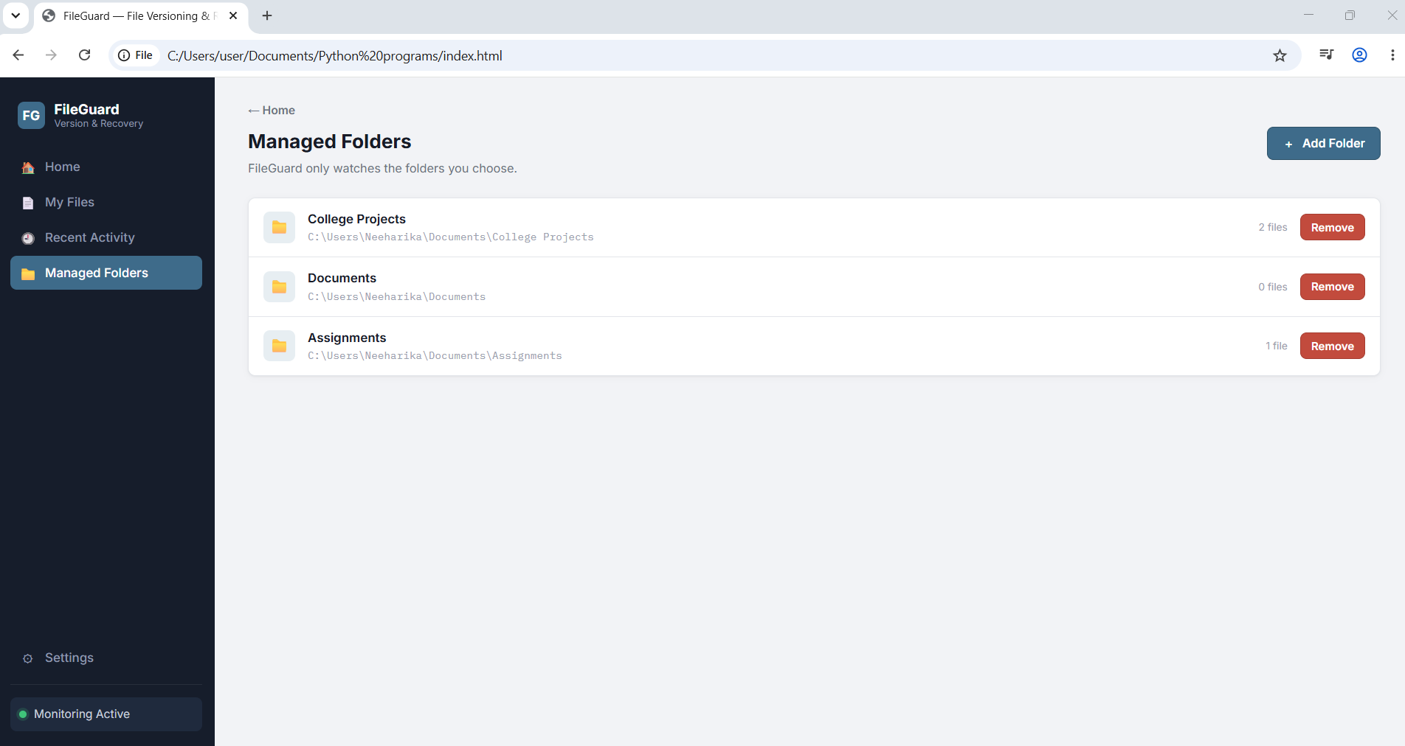
07 · FRONTEND
Frontend Implementation — Screenshots
Home
My Files
Recent Activity
Managed Folders
File Versioning & Recovery System
8

Slide 9
08 · DATABASE
Database Design — ER Diagram
Proposed database ER diagram (planned relational schema — not yet implemented).
Design Principles
USER
User_ID (PK) · Name · Email · Password
Relational schema to track ownership, files and their versions
Foreign keys link each file to a user, and each version to a file
One user can own many files; one file can have many versions
Status: database integration — to be implemented next
1 —— ↓ —— M
FILE
File_ID (PK) · File_Name · File_Path · Folder · Version_Limit · User_ID (FK)
1 —— ↓ —— M
FILE_VERSION
Version_ID (PK) · File_ID (FK) · Version_Number · Modified_Date · File_Size · File_Path
File Versioning & Recovery System
9

Slide 10
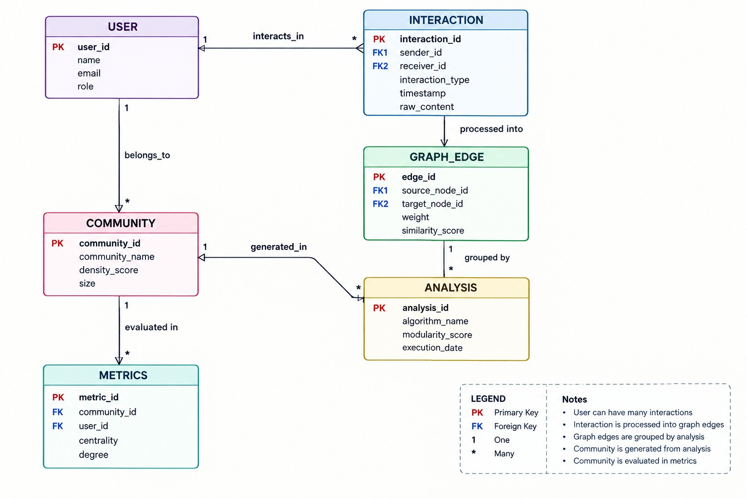
09 · DATABASE
Entity-Relationship Diagram
File Versioning & Recovery System
10

Slide 11
10 · DATABASE
Database Tables / Schema
Proposed MySQL schema — status: to be implemented.
User
File
Schema Overview
Field | Type
User_ID | INT
Name | VARCHAR
Email | VARCHAR
Password | VARCHAR
Field | Type
File_ID | INT
File_Name | VARCHAR
File_Path | VARCHAR
Folder | VARCHAR
Version_Limit | INT
User_ID | INT
User: User_ID, Name, Email, Password
File: File_ID, File_Name, File_Path, Folder, Version_Limit, User_ID
File_Version: Version_ID, File_ID, Version_Number, Modified_Date, File_Size, File_Path
File_Version
Field | Type
Version_ID | INT
File_ID | INT
Version_Number | INT
Modified_Date | DATETIME
File_Size | VARCHAR
File_Path | VARCHAR
File Versioning & Recovery System
11

Slide 12
11 · DATABASE
Sample Database Records
Sample / proposed records matching the data used in the frontend prototype.
File Table
Version Table (sample)
File_ID | File_Name | Folder | Current Version
1 | Project_Report.docx | College Projects | 7
2 | Assignment.pdf | Assignments | 3
3 | Presentation.pptx | College Projects | 12
Version_ID | File | Version
1 | Project_Report.docx | V1
2 | Project_Report.docx | V2
... | ... | ...
7 | Project_Report.docx | V7
The frontend currently generates 7 versions for Project_Report.docx, 3 for Assignment.pdf, and 12 for Presentation.pptx — matching the sample records above.
File Versioning & Recovery System
11

Slide 13
12 · STATUS
Current Progress
✓ Completed
○ To Be Implemented
Frontend Interface
MySQL database integration
Java backend services
Actual database connectivity
Persistent data storage
Real operating-system file monitoring (current build simulates file changes)
Home, My Files, Recent Activity, Managed Folders, Settings
File Management
Create file, open file, view file details, display file path
Version Management
Create version, view history & details, compare versions, restore
Folder Management
Add / remove managed folders, display folder information
Settings
Enable / disable monitoring, set version limit, auto-remove oldest, change storage location
File Versioning & Recovery System
13

Slide 14
13 · STATUS
Challenges / Issues Faced
Open technical problems that come with building version management from scratch.
!
Version Management
!
Version Limit
!
Version Comparison
Managing multiple versions of the same file and maintaining the correct version number.
Handling the maximum number of versions and removing the oldest once the autoRemove / maxVersions limit is exceeded.
Comparing two versions and identifying changes, using a line-based comparison algorithm for text-comparable files.
!
File Recovery
!
Actual File Monitoring
Restoring an older version while keeping it as a new version, rather than deleting the current history.
The current frontend simulates a monitored change ("Auto-detected edit") rather than watching real OS files.
File Versioning & Recovery System
14

Slide 15
14 · CLOSING
Conclusion
The File Versioning & Recovery System prevents accidental data loss by keeping a full, browsable history of every file change instead of silently overwriting it.
The completed frontend demonstrates the full versioning workflow end to end — creating, viewing, comparing and restoring versions.
Version limits and automatic cleanup keep storage under control without manual housekeeping.
The next phase connects this working frontend to a persistent Java + MySQL backend and real file-system monitoring.
File Versioning & Recovery System
15

Slide 16
Thank You
A File Versioning and Recovery System

